Slide 1
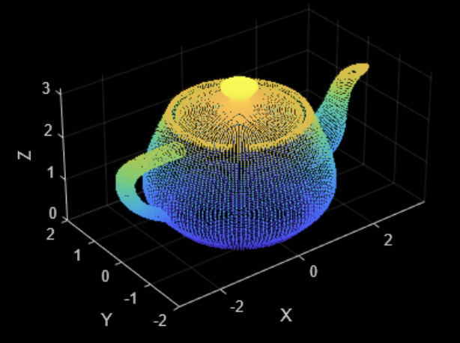
What is Point Cloud?
A point cloud:
A collection of data points defined in a three-dimensional coordinate system (X, Y, Z).
Irregular Format:
Point clouds are unordered, have variable point counts, and exhibit non-uniform distribution.

Slide 2
Traditional CNN Approach for Point Clouds:
Point Cloud → Voxelization/Image Projection
but with 2 major issues…
1. Data Explosion
• Massive memory
• 64³ grid = 262K voxels
• Computational burden
2. Information Loss
• Quantization errors
• Loss of fine details
• Geometric invariance

Slide 3
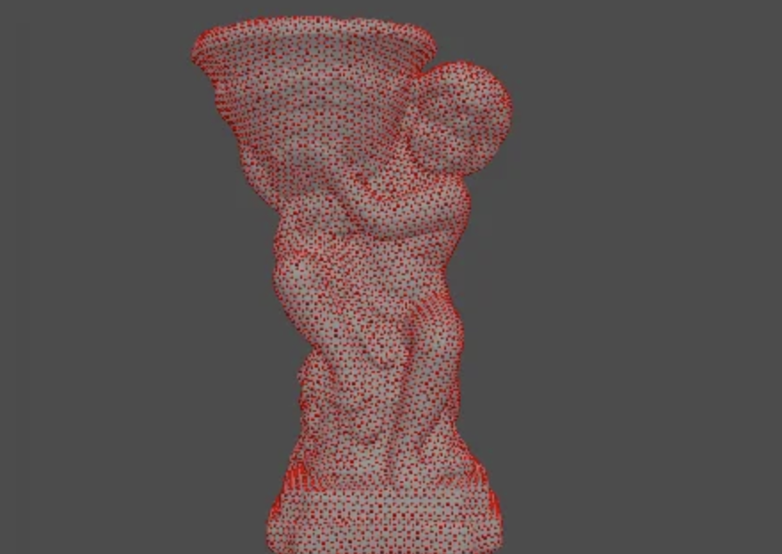
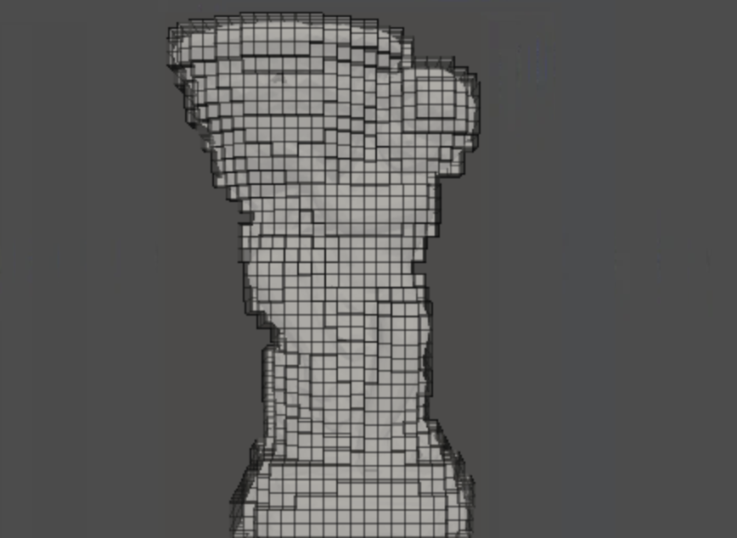
Point Cloud
3D Voxel Grids

Slide 4
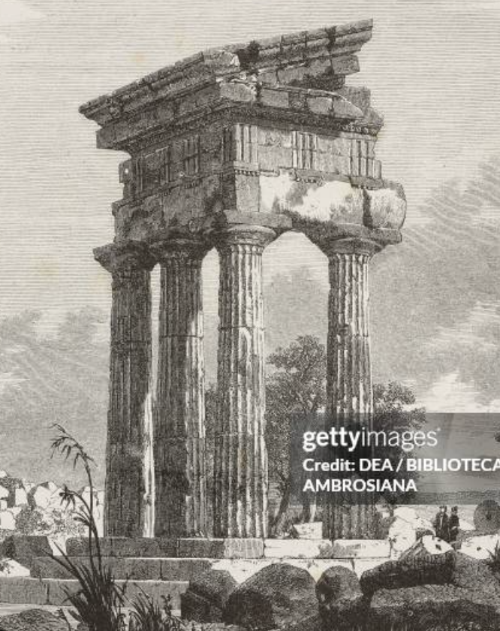
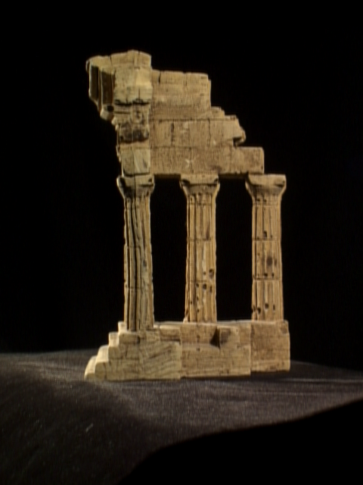
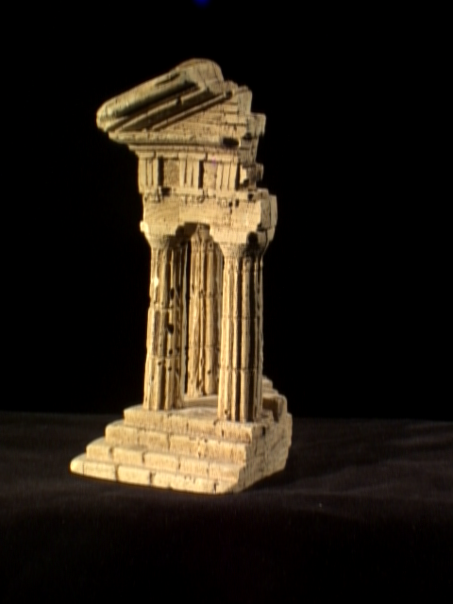
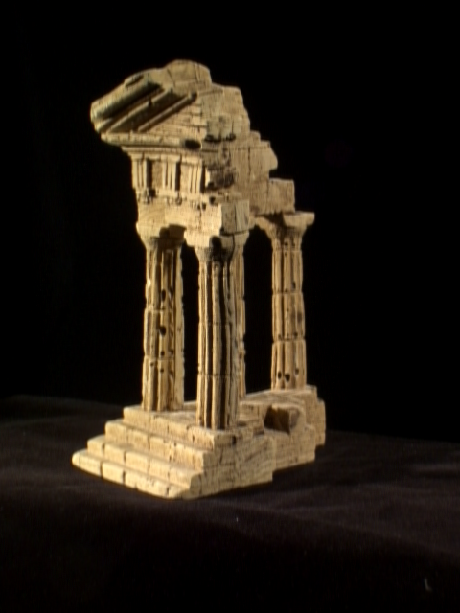
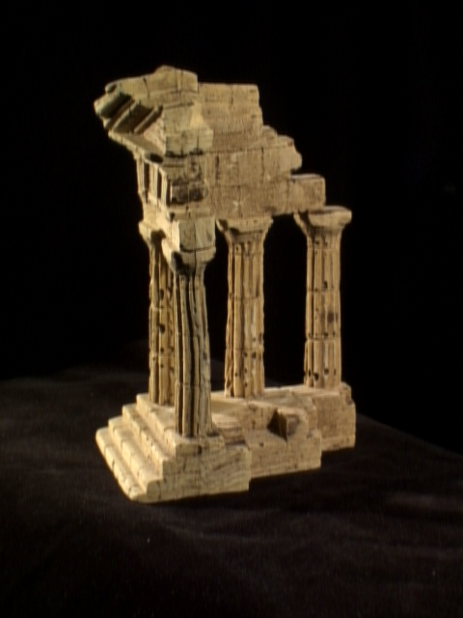
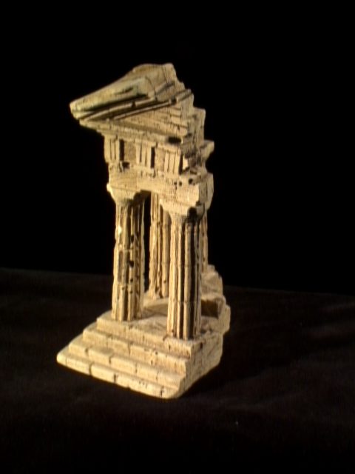
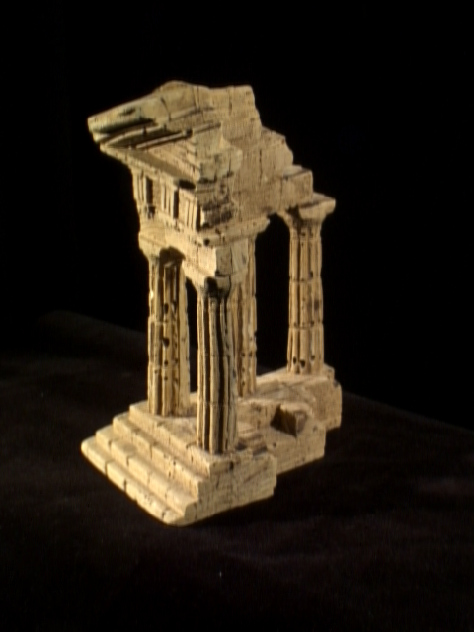
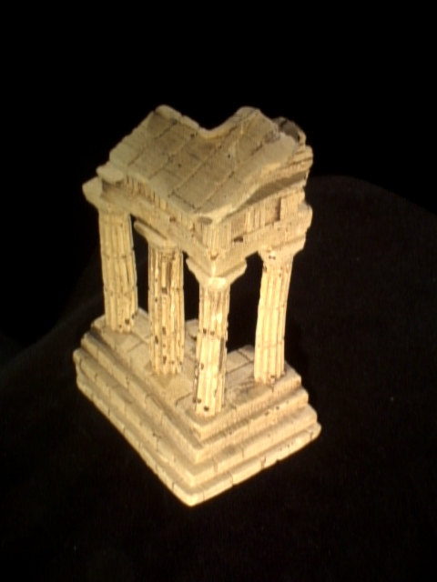
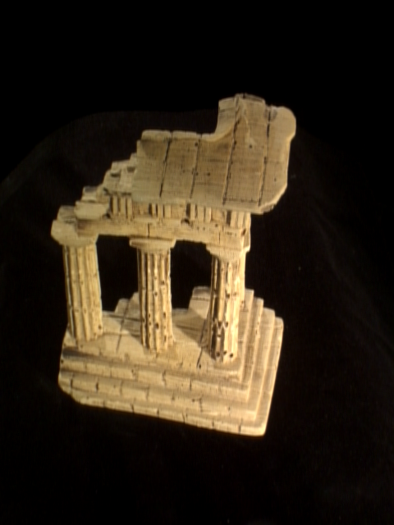
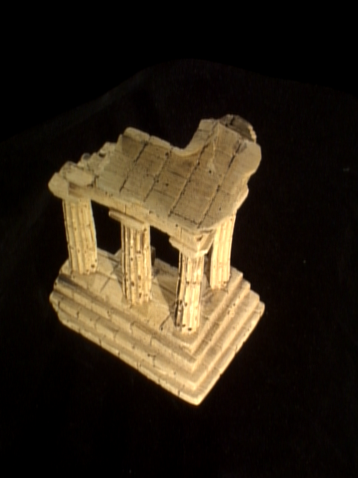
Point Cloud
Collections of images

Slide 5
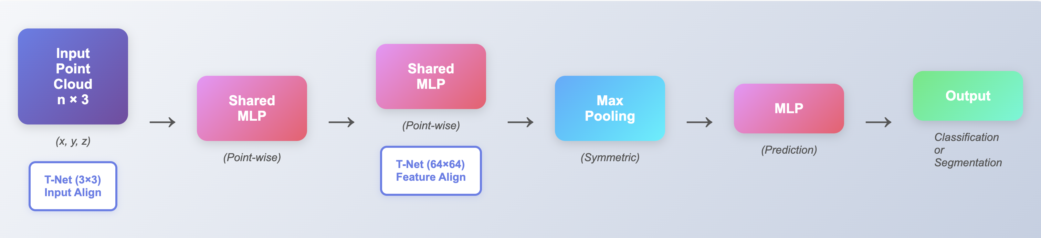
PointNet Architecture
Key ideas:
Point-wise: Shared MLP for each point
Order-free: Max pooling makes the model permutation invariant
Geometry-aware: T-Net learns point cloud alignment automatically

Slide 6
Point Cloud Features
Most features were handcrafted for specific tasks.
Features are either:
Intrinsic (shape-based, rotation-invariant)
Extrinsic (coordinate-based, change with rotation)
Also divided into:
Local features (neighborhood shape)
Global features (overall object shape)
So it’s hard to find the best feature combination for each task.
PointNet learns features directly from raw points, without handcrafting.

Slide 7
Deep Learning on 3D Data
Approach | Key Papers | Method | Pros | Cons | Accuracy
Volumetric CNN | • 3DShapeNets • VoxNet • FPNN | Voxelize → 3D Conv | 1. Mature 3D conv 2. Structured | 1. Resolution limited 2. Memory intensive 3. Sparse but dense storage | 77-86%
Multi-view CNN | • MVCNN • Vol+MV | Render → 2D Conv | 1. Leverage 2D CNNs 2. Best performance | 1. Rendering overhead 2. View selection 3. Hard to extend to segmentation | 90.1%
Spectral CNN | • Spectral • Geodesic | Graph conv on mesh | Geometric operations | 1. Only manifold meshes 2. Organic shapes only | N/A
Feature-based DNN | • 3D Deep Shape Descriptor • 3D Mesh Labeling | Features → MLP | Simple pipeline | 1. Handcrafted features 2. Not end-to-end | Lower

Slide 8
Deep Learning on Unordered Sets
Point clouds = unordered sets, rarely studied in deep learning.
Prior work (Vinyals et al.) handles general sets but no geometry.
PointNet is the first to handle unordered geometric point sets.

Slide 9
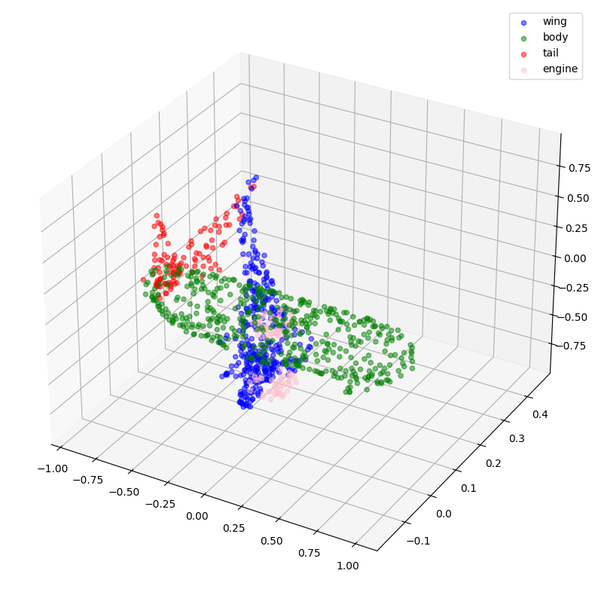
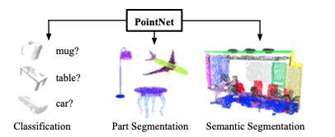
Problem Statement
Point Cloud
$$\left\{P_{i} ∈\left(x, y, z\right)\right| \left(x, y, z\right) ∈ ℝ^{3}, i=1, …,n\}$$
PointNet
Classification (k x 1)
Part Segmentation
/Semantic Segmentation
(n x m)

Slide 10
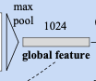
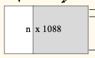
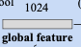
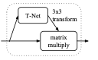
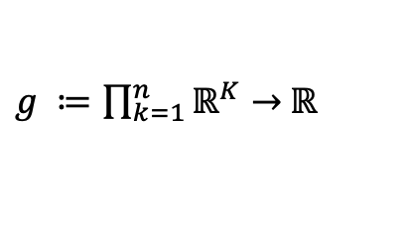
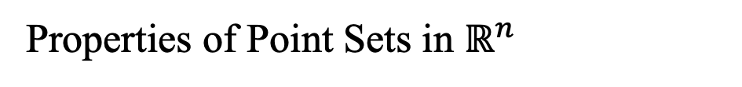

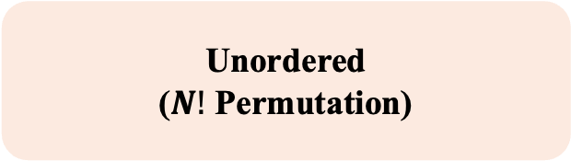
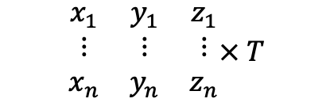
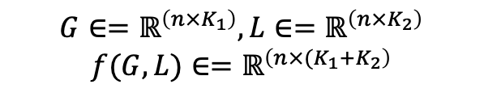
Properties of Point Sets in $ℝ^{n}$
Deep Learning on Point Sets
Unordered
($N!$ Permutation)
Symmetry Function
$$f\left(\left\{x_{1},…, x_{n}\right\}\right)≈g\left(h\left(x_{1}\right), …, h\left(x_{n}\right)\right)$$
$g ≔\prod_{k=1}^{n}{ℝ^{K}→}$ $ℝ$
Locality
(Interaction among points)
Local and Global Information Aggregation
$$f\left(G, L\right)≈Concat(G, L, axis=1)$$
$$G∈=ℝ^{\left(n×K_{1}\right)}, L∈=ℝ^{\left(n×K_{2}\right)}$$
$$f(G, L)∈=ℝ^{\left(n×{(K}_{1}+K_{2}\right)}$$
Joint Alignment Network
Invariance under transformations
$$\begin{matrix}x_{1} & y_{1} & z_{1} \\ ⋮ & ⋮ & ⋮ \\ x_{n} & y_{n} & z_{n}\end{matrix}× T$$
$$T∈=ℝ^{\left(3×3\right)}$$

Slide 11
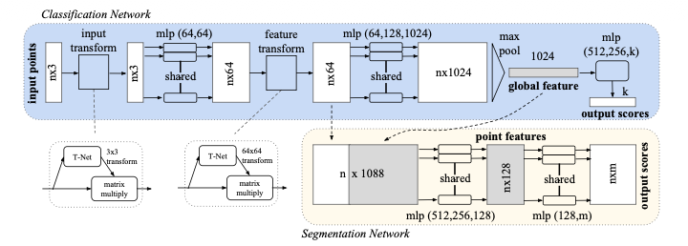
PointNet Architecture
Deep Learning on Point Sets

Slide 12
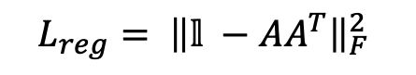
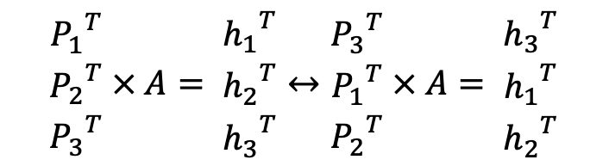
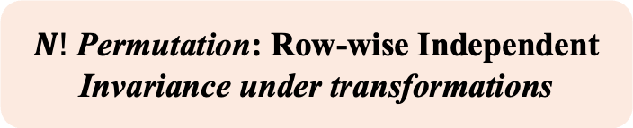
PointNet Architecture
Deep Learning on Point Sets
Input/Feature Transform
$N!$ Permutation: Row-wise Independent
Invariance under transformations
$$\begin{matrix}{P_{1}}^{T} \\ {P_{2}}^{T} \\ {P_{3}}^{T}\end{matrix} × A= \begin{matrix}{h_{1}}^{T} \\ {h_{2}}^{T} \\ {h_{3}}^{T}\end{matrix}↔\begin{matrix}{P_{3}}^{T} \\ {P_{1}}^{T} \\ {P_{2}}^{T}\end{matrix} × A= \begin{matrix}{h_{3}}^{T} \\ {h_{1}}^{T} \\ {h_{2}}^{T}\end{matrix}$$
$$L_{reg}= {\left\|𝕝 −AA^{T}\right\|}_{F}^{2}$$
T-Net: predict Affine Transformation Matrix

Slide 13
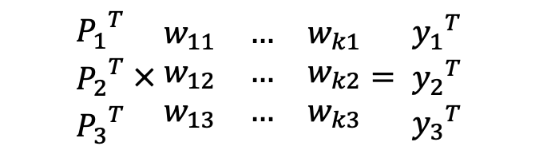
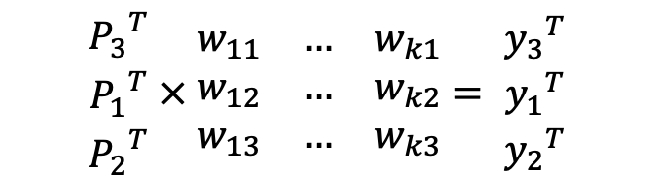
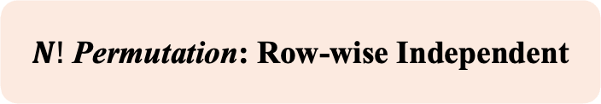
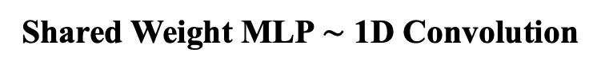
PointNet Architecture
Deep Learning on Point Sets
Shared Weight MLP $\sim$ 1D Convolution
$N!$ Permutation: Row-wise Independent
$\begin{matrix}{P_{1}}^{T} \\ {P_{2}}^{T} \\ {P_{3}}^{T}\end{matrix} × \begin{matrix}w_{11} & … & w_{k1} \\ w_{12} & … & w_{k2} \\ w_{13} & … & w_{k3}\end{matrix}= \begin{matrix}{y_{1}}^{T} \\ {y_{2}}^{T} \\ {y_{3}}^{T}\end{matrix}$
$\begin{matrix}{P_{3}}^{T} \\ {P_{1}}^{T} \\ {P_{2}}^{T}\end{matrix} × \begin{matrix}w_{11} & … & w_{k1} \\ w_{12} & … & w_{k2} \\ w_{13} & … & w_{k3}\end{matrix}= \begin{matrix}{y_{3}}^{T} \\ {y_{1}}^{T} \\ {y_{2}}^{T}\end{matrix}$

Slide 14
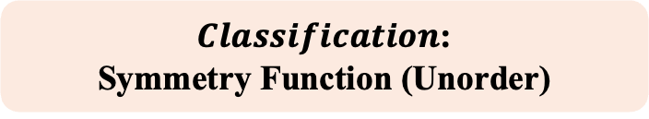
PointNet Architecture
Deep Learning on Point Sets
MaxPooling (axis = 0)
$Classification$:
Symmetry Function (Unorder)
$maxpool\left(P_{1},P_{2}, P_{3}\right)=$ $maxpool\left(P_{3},P_{1}, P_{2}\right)$
Universal approximation & Stability

Slide 15

PointNet Architecture
Deep Learning on Point Sets
$$Segmentation:$$
Interaction among Points
Concatenate (axis = 1)
Combination of Local Geometry and Global Semantic

Slide 16

PointNet Architecture
Deep Learning on Point Sets
Classification: (k x 1)
$$Output of PointNet$$
k class label
Segmentation: (n x m)
m class(part) label for every points

Slide 17
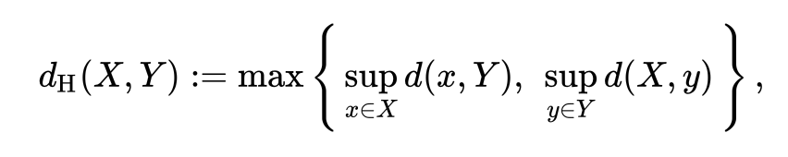
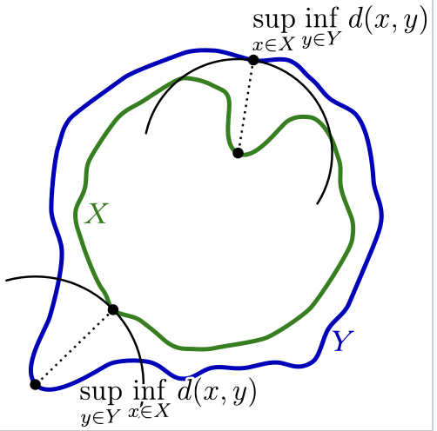
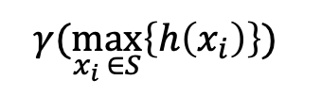
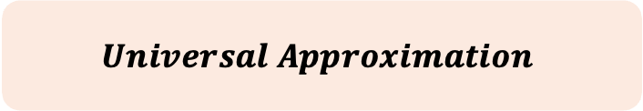
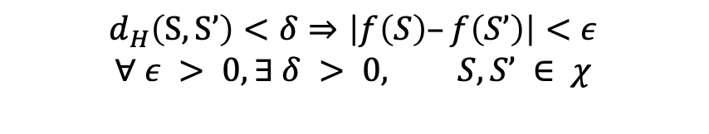

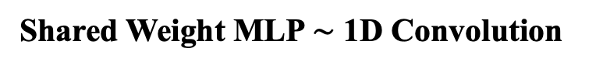
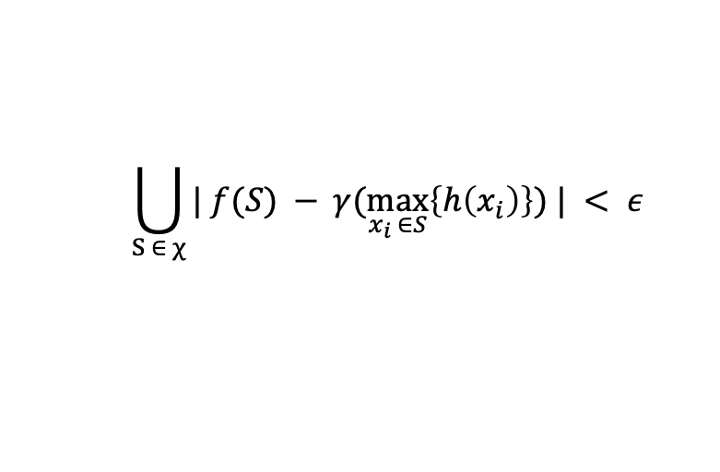
Bottleneck dimension and stability
Supplementary
Input/Feature Transform
$$Universal Approximation$$
Shared Weight MLP $\sim$ 1D Convolution
$$γ(\max_{x_{i} ∈S}\left\{h\left(x_{i}\right)\right\})$$
MaxPooling (axis = 0)
MLP
$$f: χ →ℝ$$
$$χ=\{S|S⊆{\left[0,1\right]}^{3},\left|S\right|=n\}$$
Hausdorff distance
$$d_{H}\left(S,S’\right)<δ⇒\left|f\left(S\right)–f\left(S’\right)\right|<ε$$
$$∀ ε > 0, ∃ δ > 0, S, S’ ∈ χ$$
Continuity
$$\bigcup_{S ∈ χ}{| f(S) − }γ(\max_{x_{i} ∈S}\left\{h\left(x_{i}\right)\right\}) | < ε$$

Slide 18
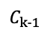
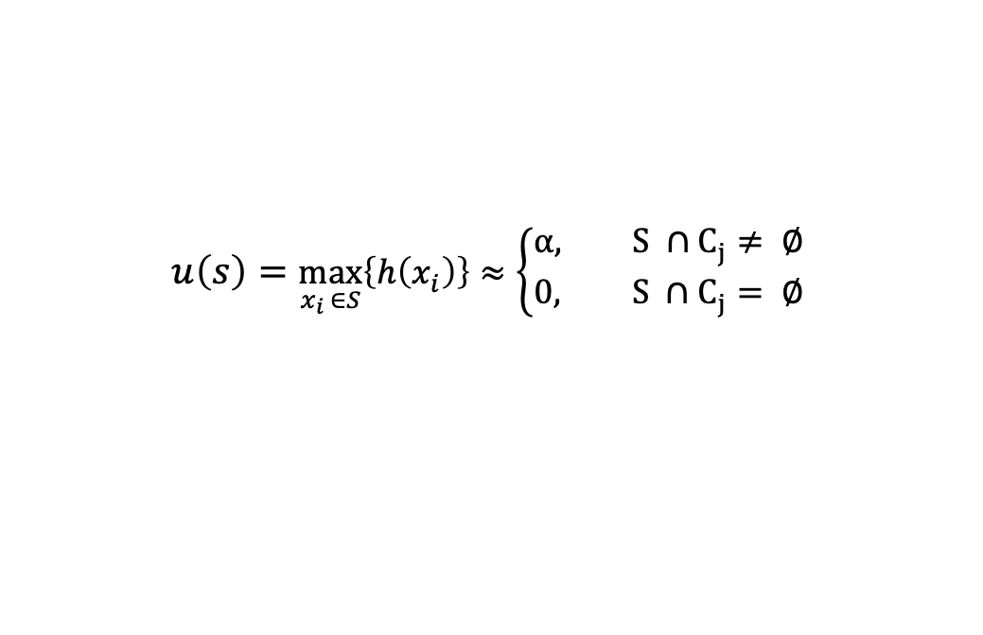
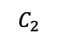
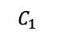

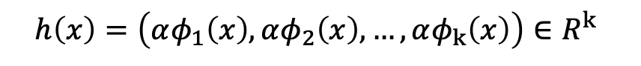
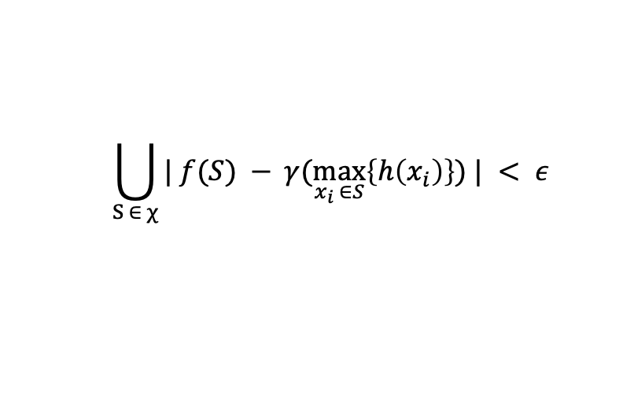
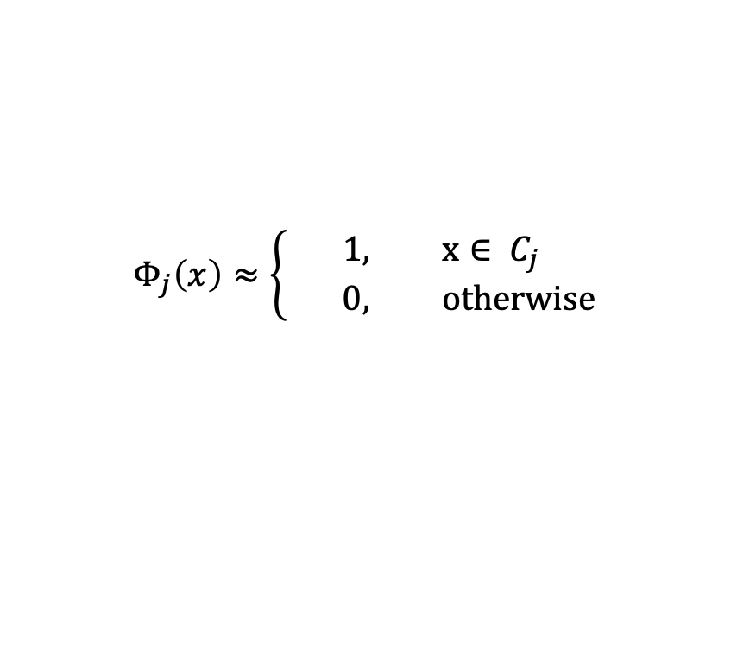
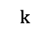
Bottleneck dimension and stability
Supplementary
$$Universal Approximation$$
0
1
…
Partition into k
$$C_{1}$$
$$C_{2}$$
$$C_{k−1}$$
$$k$$
$$Φ_{j}\left(x\right)≈\left\{\begin{aligned}1, x∈ C_{j} \\ 0, otherwise\end{aligned}\right.$$
But continuous like Dirac-Delta Function
$$h\left(x\right)=\left(αφ_{1}\left(x\right),αφ_{2}\left(x\right),…,αφ_{k}\left(x\right)\right)∈R^{k}$$
$$u\left(s\right)=\max_{x_{i} ∈S}\left\{h\left(x_{i}\right)\right\}≈\left\{\begin{aligned}α, S ∩C_{j}≠ ∅ \\ 0, S ∩C_{j}= ∅\end{aligned}\right.$$
$$γ\left(x\right) :ℝ^{k}→ℝ$$
$$\bigcup_{S ∈ χ}{| f(S) − }γ(\max_{x_{i} ∈S}\left\{h\left(x_{i}\right)\right\}) | < ε$$
$∴$ sufficiently large k, $γ(\max_{x_{i} ∈S}\left\{h\left(x_{i}\right)\right\})$ can approximate any permutation invariance function.

Slide 19
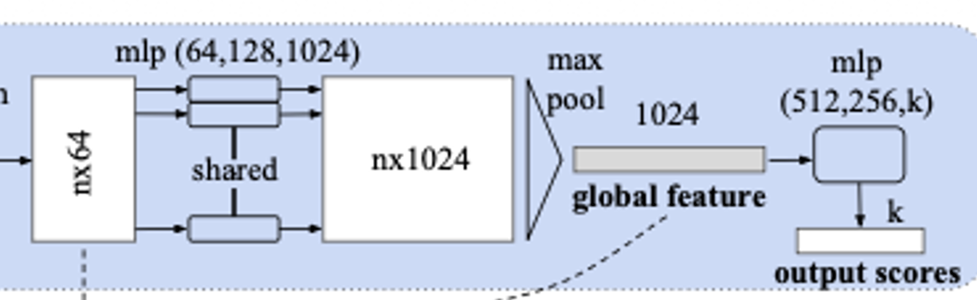







Bottleneck dimension and stability
Supplementary
$$Bottleneck dimension and stability$$
MaxPooling (axis = 0)
$$u= \max_{x_{i} ∈S}\left\{h\left(x_{i}\right)\right\}$$
$$u : χ→ ℝ^{K}$$
Bottleneck k
$$S$$
(a)$∀S,∃C_{S},N_{S}⊆χ,f\left(T\right)=f\left(S\right) ifC_{S}⊆T⊆N_{S}$
(b) $|C_{S}|≤K$
$$S’$$
$$f\left(S\right)=f\left(S’\right)$$
Stability

Slide 20


Experiments
Task1: 3D Classification
Dataset:
ModelNet40
(12K shapes, 40 classes)
Results:
MVCNN: 90.1% (80 views)
VoxNet: 85.9% (12 views)
PointNet: 89.2% (single view)
→ On par with SOTA → 141× faster than MVCNN

Slide 21

Experiments
Task2: Part Segmentation
Dataset:
ShapeNet Parts
(16K shapes, 50 parts)
Results:
Yi et al.: 81.4% mIoU
3D CNN: 79.4% mIoU
PointNet: 83.7% mIoU
→ +2.3% improvement → Robust to missing / partial points

Slide 22

Experiments
Task3: Scene Segmentation
Dataset:
Stanford 3D Indoor Scenes
(271 rooms, 13 classes)
Results:
Baseline: 20.1% mIoU
PointNet: 47.7% mIoU
→ 137% relative improvement
→ Unified architecture for all tasks

